Slide 1
Coordination Chemistry
Coordination compounds are also acid-base adducts.
Transition metals act as Lewis acids
Form complexes/complex ions
Fe³⁺(aq) + 6CN⁻(aq) → [Fe(CN)₆]³⁻(aq)
Ni²⁺(aq) + 6NH₃(aq) → [Ni(NH₃)₆]²⁺(aq)
Lewis acid
Lewis base
Complex ion
Lewis acid
Lewis base
Complex ion
Complex contains central M⁺bonded to one or more ligands
Lewis acid = metal ion = center of coordination
Lewis base = ligand = molecules/ions bonded to M⁺

Slide 2
Theories / Concepts
Bonding in transition metal compounds
Werner Coordination Theory
18 electron rule
Valence Bond Theory
Crystal field theory
Molecular orbital approach
High spin and low spin complexes
Spectrochemical series
CFSE
Jahn-Teller distortions

Slide 3
Werner Coordination Theory
Werner : 1893 (electron was discovered in 1896) Nobel prize in 1913.
In complexes, metal ions show two different types of valency:
Primary Valency: Non-directional, is the number of charges on the complex ion.
Secondary Valency: Directional, equals to the number of ligands coordinated to the metal.

Slide 4
18 electron rule (based on earlier EAN Rule: Sidgwick)
Stable low oxidation state complexes are found to have a total of 18 bonding electrons
metal electrons + lone pairs from ligands = 18
Ni(CO)₄ - 4s²3d⁸ and 4 lone pairs
Fe(CO)₅ - 4s²3d⁶ and 5 lone pairs
Cr(CO)₆ - 4s²3d⁴ and 6 lone pairs
The stability of these 18 electron species can be explained using MO theory.
Corresponds to filling all the molecular bonding orbitals and none of the antibonding orbitals
However, rule is only works for species with metals in a low oxidation state NOT FOR MOST COMPLEXES.

Slide 5
Valence Bond Theory
The idea that atoms form covalent bonds by sharing pairs of electrons was first proposed by G. N. Lewis in 1902.
In 1927, Walter Heitler and Fritz London showed how the sharing of pairs of electrons holds a covalent molecule together.
The Heitler-London model of covalent bonds was the basis of the VBT.
The last major step in the evolution of this theory was the suggestion by Linus Pauling that atomic orbitals mix to form hybrid orbitals, such as the sp, sp², sp³, sp³d² and d²sp³ orbitals.

Slide 6
VBT – Assumptions / Features
Coordination compounds contain metal ions, in which ligands form covalent-coordinate bonds to the metal.
Ligands must have a lone pair of electrons.
Metal should have an empty orbital of suitable energy available for bonding.
Atomic orbitals are used for bonding (rather than molecular orbitals)
This theory is useful to predict the shape and stability of the metal complexes.
Limitations: (1) Does not explain why some complexes are colored and others are not; it not clear why some complexes are high or low . (2) Does not explain the temp. dependence of the magnetic properties.

Slide 7
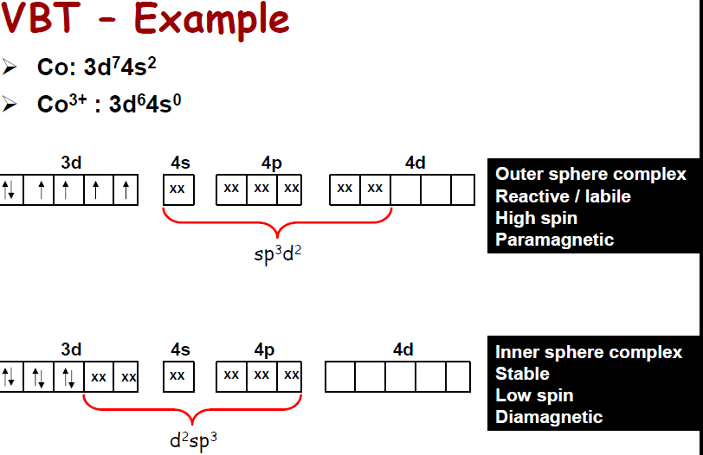

Slide 8
Crystal Field Theory (Text : JD Lee; pp.204-222)
This theory (CFT) largely replaced VB Theory for interpreting the chemistry of coordination compounds.
It was proposed by the physicist Hans Bethe in 1929.
Subsequent modifications were proposed by J. H. Van Vleck in 1935 to allow for some covalency in the interactions.
These modifications are often referred to as Ligand Field Theory.
For a review on the evolution of bonding models see: C. J. Ballhausen, J. Chem. Ed. 1979 56 194-197, 215-218, 357-361.

Slide 9
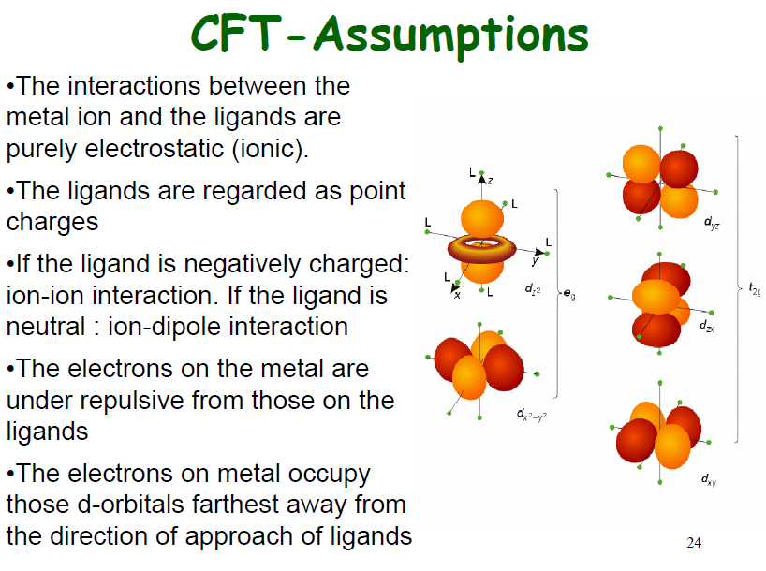

Slide 10
Crystal Field Theory
Crystal Field Theory
Model for bonding in transition metal complexes
Accounts for observed properties of transition metal complexes
Focuses on d-orbitals
Ligands = point negative charges
Assumes ionic bonding
electrostatic interactions

Slide 11
d orbitals

Slide 12
Crystal Field Theory
Electrostatic Interactions
(+) metal ion attracted to (-) ligands (anion or dipole)
provides stability
lone pair e⁻’s on ligands repulsed by e⁻’s in metal d orbitals
interaction called crystal field
influences d orbital energies
not all d orbitals influenced the same way

Slide 13
Crystal Field Theory
-
Octahedral Crystal Field
-
-
(-) Ligands attracted to (+) metal ion; provides stability
+
-
-
d orbital e⁻’s repulsed by (–) ligands; increases d orbital potential energy
-
ligands approach along x, y, z axes

Slide 14
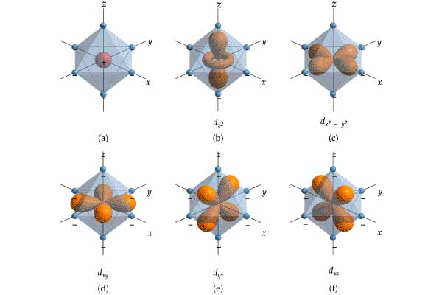

Slide 15
Crystal Field Theory
octahedral crystal field
d orbital energy levels
d_{z}2
d_{x}2_{- y}2
_ _
_ _ _
E
d_{xy}
d_{xz}
d_{yz}
isolated metal ion
_ _ _ _ _
metal ion in octahedral complex
d-orbitals

Slide 16
Crystal field theory
Factors affecting the C.F.S or 10Dq
Nature of metal ion
Nature of ligand
Geometry

Slide 17
Nature of metal ion:
Charge of metal α splitting magnitude or 10Dq
Eg. Fe⁺² -------10,400 cm-1, Fe+3 -------13,700 cm-1
Charge on different metal ion α splitting magnitude or 10Dq
Eg. V+2-------12,400cm-1, Cr+3-------17,400cm-1
Number of d-electrons increases splitting decreases
No. of d-electrons α 1/10Dq eg. d7-------Co+2----------9,300cm-1
d8-------Ni+2-----------6,500cm-1
As quantum number of metal ion increases splitting magnitude also increases . 3d→4d→5d (as size increases 30-50% splitting increases)

Slide 18
As quantum number of metal ion increases splitting magnitude also increases . 3d→4d→5d (as size increases 30-50% splitting increases)
Eg. [Co(NH₃)₆]⁺³ --------2300cm-1, [Rh(NH₃)₆]⁺³ --------31,300cm-1
[Ir(NH₃)₆]⁺³ --------44,300cm-1
Nature of ligand------Weak field and strong field ligand
A series of common ligands arranged with increasing order their C.F.S magnitude with any given ion to result spectrochemical series.

Slide 19
Spectrochemical Series
Colors of Transition Metal Complexes
Smallest Δ
Δ increases
Largest Δ
I⁻ < Br⁻ < Cl⁻ < F⁻ < OH⁻ < H₂O < NH₃ < en < CN⁻
strong field
weak field

Slide 20
Geometry of complex: octahedral -------10Dq, Td-------4.5 Dq….due to arrangement of ligands Magnetic properties:
Magnetic properties of transition metal complexes
Many are paramagnetic
# of unpaired electrons depends on the ligand
[Fe(CN)₆]³⁻ has 1 unpaired d electron
[FeF₆]³⁻ has 5 unpaired d electrons
Class activity: Calculate the magnetic moment of [Co(NH₃)₆]⁺³ ?

Slide 21
Crystal Field Theory
Crystal Field Theory
Can be used to account for
Colors of transition metal complexes
A complex must have partially filled d subshell on metal to exhibit color
A complex with 0 or 10 d e⁻s is colorless

Slide 22
Colors of Transition Metal Complexes
Compounds/complexes that have color:
absorb specific wavelengths of visible light (400 –700 nm)
wavelengths not absorbed are transmitted

Slide 23
Visible Spectrum
wavelength, nm
(Each wavelength corresponds to a different color)
400 nm
700 nm
higher energy
lower energy
White = all the colors (wavelengths)

Slide 24
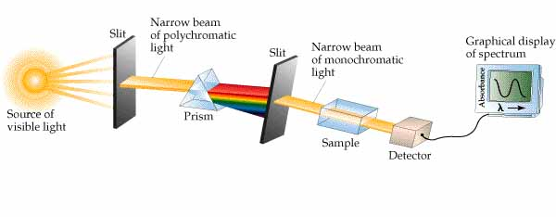
Visible Spectrum

Slide 25
Colors of Transition Metal Complexes
Compounds/complexes that have color:
absorb specific wavelengths of visible light (400 –700 nm)
wavelengths not absorbed are transmitted
color observed = complementary color of color absorbed

Slide 26
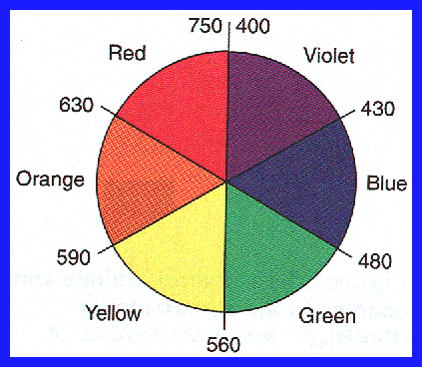
absorbed color
observed color

Slide 27
Colors of Transition Metal Complexes
Absorption of UV-visible radiation by atom, ion, or molecule:
Occurs only if radiation has the energy needed to raise an e⁻ from its ground state to an excited state
i.e., from lower to higher energy orbital
light energy absorbed = energy difference between the ground state and excited state
“electron jumping”

Slide 28
metal ion in octahedral complex
octahedral crystal field
d orbital energy levels
d_{z}2
d_{x}2_{- y}2
_ _
Δ
_ _ _
E
d_{xy}
d_{xz}
d_{yz}
isolated metal ion
_ _ _ _ _
Metal ion and the nature of the ligand determines Δ
d-orbitals

Slide 29
Colors of Transition Metal Complexes
green light observed
white light
red light absorbed
For transition metal complexes, Δ corresponds to energies of visible light.
Absorption raises an electron from the lower d subshell to the higher d subshell.

Slide 30
Colors of Transition Metal Complexes
Different complexes exhibit different colors because:
color of light absorbed depends on Δ
larger Δ = higher energy light absorbed 
Shorter wavelengths
smaller Δ = lower energy light absorbed
Longer wavelengths
magnitude of Δ depends on:
ligand(s)
metal

Slide 31
Colors of Transition Metal Complexes
green light observed
white light
red light absorbed (lower energy light)
[M(H₂O)₆]³⁺

Slide 32
Colors of Transition Metal Complexes
white light
blue light absorbed (higher energy light)
orange light observed
[M(en)₃]³⁺

Slide 33
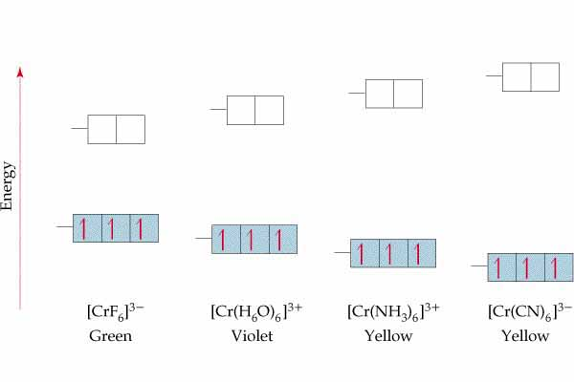

Slide 34
Electronic Configurations of Transition Metal Complexes
d orbital occupancy depends on Δ and pairing energy, P
e⁻’s assume the electron configuration with the lowest possible energy cost
If Δ > P (Δ large; strong field ligand)
e⁻’s pair up in lower energy d subshell first 
If Δ < P (Δ small; weak field ligand)
e⁻’s spread out among all d orbitals before any pair up

Slide 35
d-orbital energy level diagrams octahedral complex
d¹

Slide 36
d-orbital energy level diagrams octahedral complex
d²

Slide 37
d-orbital energy level diagrams octahedral complex
d³

Slide 38
d-orbital energy level diagrams octahedral complex
d⁴
low spin
Δ > P
high spin Δ < P

Slide 39
d-orbital energy level diagrams octahedral complex
d⁵
low spin
Δ > P
high spin Δ < P

Slide 40
d-orbital energy level diagrams octahedral complex
d⁶
low spin
Δ > P
high spin Δ < P

Slide 41
d-orbital energy level diagrams octahedral complex
d⁷
low spin
Δ > P
high spin Δ < P

Slide 42
d-orbital energy level diagrams octahedral complex
d⁸

Slide 43
d-orbital energy level diagrams octahedral complex
d⁹

Slide 44
d-orbital energy level diagrams octahedral complex
d¹⁰

Slide 45
Electronic Configurations of Transition Metal Complexes
Determining d-orbital energy level diagrams:
determine oxidation # of the metal
determine # of d e⁻’s
determine if ligand is weak field or strong field
draw energy level diagram

Slide 46
Spectrochemical Series
Colors of Transition Metal Complexes
Smallest Δ
Δ increases
Largest Δ
I⁻ < Br⁻ < Cl⁻ < F⁻ < OH⁻ < H₂O < NH₃ < en < CN⁻
strong field
weak field

Slide 47
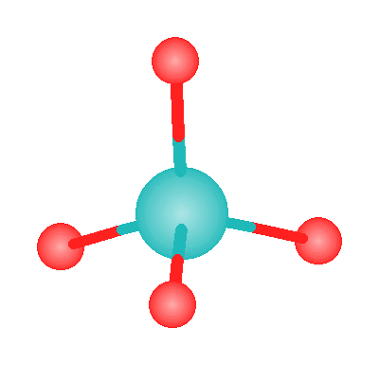
d-orbital energy level diagrams tetrahedral complex

Slide 48
d-orbital energy level diagram
metal ion in tetrahedral complex
d_{xy}
d_{xz}
d_{yz}
_ _ _
Δ
_ _
E
d_{z}2
d_{x}2_{- y}2
isolated metal ion
only high spin
_ _ _ _ _
d-orbitals

Slide 49
d-orbital energy level diagram
metal ion in square planar complex
__
d_{x}2_{- y}2
__
d_{xy}
__
d_{z}2
E
__
__
isolated metal ion
d_{xz}
d_{yz}
_ _ _ _ _
only low spin
d-orbitals

Slide 50
Crystal field stabilization energy(CFSE)
The crystal field stabilization energy (CFSE) is the energy by which the complex is stabilized relative to the free metal atom where there is no splitting of d orbitals.
It can be calculated by:
CFSE_{highspin}= {(n_{eg} x 3/5) – (n_{t2g} x 2/5)} Δ₀
where n_{eg} = number of electrons in e_{g} orbitals
n^{t}_{2g} = number of electrons in t_{2g} orbitals.
CFSE_{lowspin} = {(n_{eg} x 3/5) – (n_{t2g} x 2/5)} Δ₀ ₊ pairing energy (P.E)

Slide 51
Application of C.F.S.E
Predict the stability of oxidation state of metal ion
Eg-1: Co⁺² , Co⁺³ --------6H₂O
C.F.S.E= ?
Eg.2. Co⁺², Co⁺³-------------6NH₃
C.F.S.E= ?

Slide 52
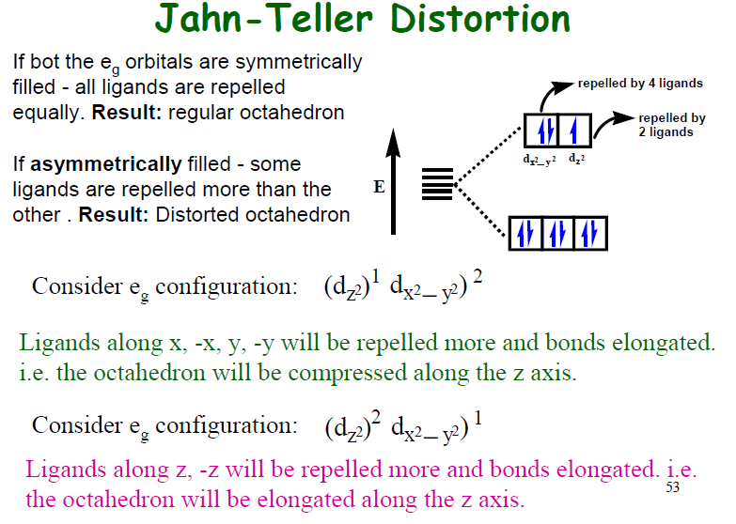

Slide 53
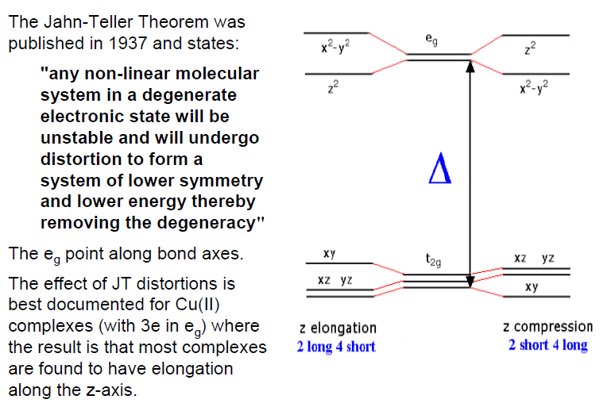

Slide 54
Molecular orbital theory(MOT)
MO: range of bonding types
Varying from largely ionic to largely covalent.
Atomic orbitals (AO) with the same symmetry, similar energy and significant overlap combined to produce molecular orbitals.
No. of AO overlap= No. of MO produced
Bonding and antibonding molecular orbitals formed.
In complexes : situation is more complicated but basic approach is
the same
Eg. Octahedral complexes: 9 metals orbitals (4s + 4p + 3d)
six LGs (six ligand group orbitals)

